Slide 1
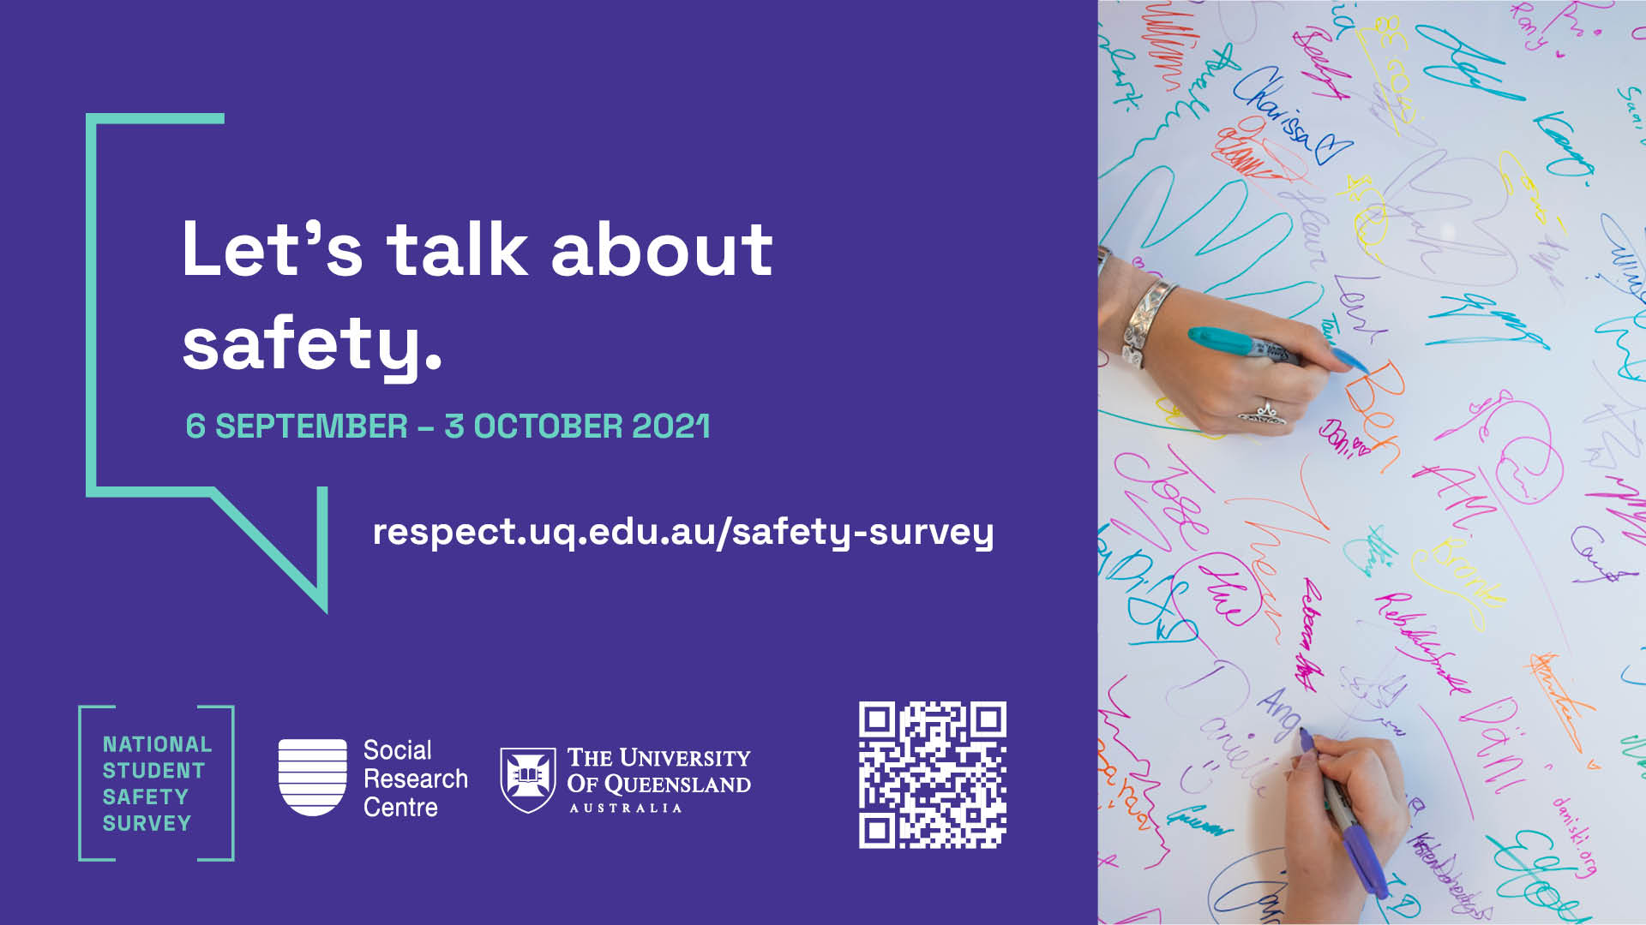

Slide 2
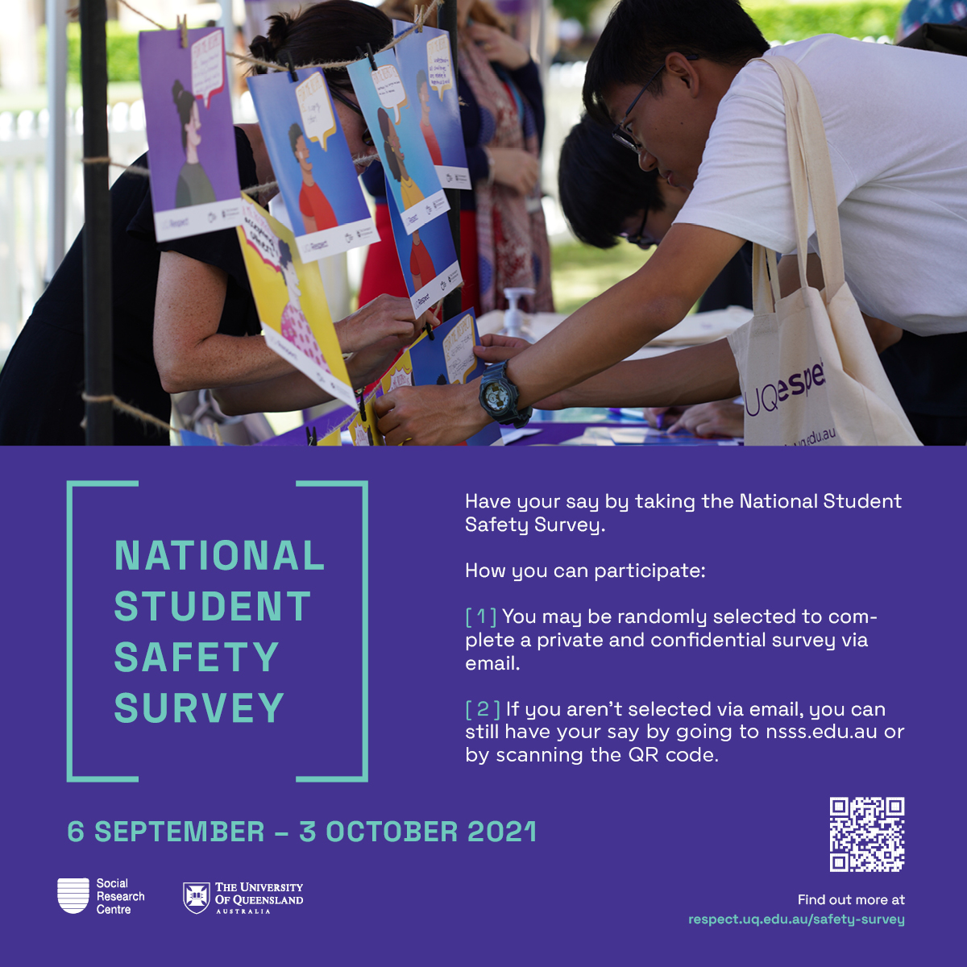
National Student Safety Survey (6 September – 3 October)
The National Student Safety Survey is being conducted by the Social Research Centre from 6 September - 3 October 2021. This is the second national survey under the Respect. Now. Always. Initiative and aims to measure student perceptions of safety at Australian universities and experiences relating to sexual assault and sexual harassment.
The University of Queensland is committed to ensuring our campuses are safe and respectful environments for all members of the community and are actively supporting the roll-out of this survey across our campuses.
During the survey period, please keep an eye on your student email, as students will be randomly selected to participate. If you are not selected, you can still have your say and find more information about the National Student Safety Survey here: https://respect.uq.edu.au/safety-survey.

